Slide 1
Algorithm and Data Structure
Week 1

Slide 2
Topics
Introduction
Object Oriented Concept
Class
Object
Attribute
Method
Instantiation
Constructor

Slide 3
Intro (1)
Teacher:
Name: Imam Fahrur Rozi
Phone : 085233139738
Email : imam.rozi@polinema.ac.id
Address: Gajayana Inside B9, Dinoyo
Role:
On time
Be quite in class/lab,
Highly recommended to ask or perform a discussion, at any time, any place ☺
Make a note only to those that are not on the slide/jobsheet
Be Positive thinking, you will be able to master this course ☺
Highly recommended to study as a study group
Be active at lms.jti.polinema.ac.id

Slide 4
Intro (2)
Materi :
Week 1. Object
Week 2. Array of Object
Week 3. Bruteforce,devide-conquer
Week 4. Quiz
Week 5. Sorting (Bubble, selection, insertion)
Week 6. Searching(Sequential, Binary)
Week 7. Stack
Week 8. Queue.
Week 9. Middle Exam
Week 10. Linked List
Week 11. Double linked List
Week 12. Tree (Binary)
Week 13. Quiz
Week 14. Tree (Binary search tree)
Week 15. DFS, BFS
Week 16. Graph
Week 17. Final Exam
Penilaian:
Quiz : 15%, UTS : 30%, UAS : 35%, Tugas : 20%

Slide 5
Intro (3)
Tools:
Java
NetBeans
Star UML

Slide 6
1 – Object Oriented Programming Concept
Java is a programming language that fully implements all OOP (Object Oriented Programming) concept
OOP is a programming paradigm that constructs a program/system as a collection of object which interacts each others.
Object as a major concern
Then, if you are going to develop a system or program, you willl need to identify the objects that compose the system

Slide 7
1 - Object Oriented Programming Concept
 | OOP | Procedural/Functional
Viewpoint | Program is a collection of objects that interacts each other | Program is a collection of process/sub-process/function
Main Concern | Object | Process/ Sub-process/Procedure/Function
Example 1 | Classroom system: Student Teacher Course Presence Form Examination | Classroom system: Ask Answer Present Do Exam

Slide 8
1 - Object Oriented Programming Concept
 | OOP | Procedural
Example 2 | Banking System: Account Customer Money | Banking System: Deposit Withdraw Transfer

Slide 9
1 - Object Oriented Programming Concept
The most basic concepts of OOP are (1) Class and (2) Object
Other concept:
Encapsulation
Inheritance
Polimorphism
In this course we will concern only at Class and Object and its implementation
The remains will be discussed at Semester 3

Slide 10
2 - Object
Object is main component in OOP
Objects correspond to real things found in the real world.
It may be tangible or intangible. But of course it must be a real thing
Objects found in a class room:
Table 1, table 2, …, table 30
Student 1, Student2…Student 30
LCD
Whiteboard
Computer
Air conditioner
Lamp 1, Lamp 2,…., Lamp 6

Slide 11
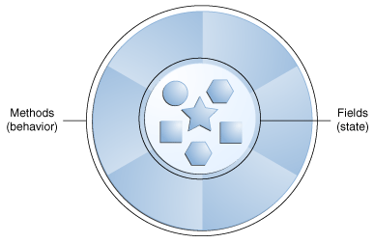
2 – Object
Characteristics of Object:
Has something → data/character/property/variabel/state/field/attribute
Can do something → behaviour/function/procedure/method

Slide 12
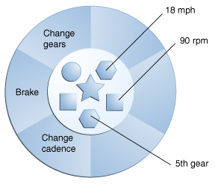
2 – Object
Object example:
Object Bicycle
Attribute | Method
Gear = 5 | Change Gears
Speed = 18 | - Brake
Rpm = 90 | - Change Cadence

Slide 13
2 – Object
Contoh Object:
Object Student
Attribute | Method
NIM = 1614210045 | Do Exam
Name = John Doe | - View Report
GPA= 3.5 | - View Payment Record
Address= Malang

Slide 14
3 - Class
Object comes from design. Before an object is created, it must be a design from which the object created. It is called as Class
Class is template/blueprint/prototype/design from which objects are created
Process creating an object from a class called as instantiation
Object will not be able to be instantiated/be created, if there is no class that defines the template.
Class will not be able to be used, if it is not created to be an object. It will be still blueprint/concept/template/design

Slide 15
3 – Class
 | Class | Object
Description | It is a design/template/prototype/blueprint | It is a riil object created from a class
Characteristik | General | Specific
Example | Student Teacher Course | Student1, Student2, etc TeacherA, TeacherB, etc Course OOP, course database

Slide 16
3 – Class
Does Class have attribute and method as well as Object?
Yes, Class also has attribute and method, as well as object. The only difference is, attribute and method of Class are still design/template/blueprint so that they could not be used directly, while attribute and method of object are riil. They are able to be accessed.

Slide 17
3 - Class
Format of Class declaration:
class ClassName{
//attribute declaration
//method declaration
}
Example:
class Bicycle{
}

Slide 18
3 - Class
Class Naming Convention
Class name must be a noun
Class name must be written as Capital Camel Case
Example:
Student
InternationalStudent
VisitingLecturer

Slide 19
4 - Attribute
Attribute : data/property owned by object or class
Example : class or object of Student has studentRegistrationNumber, name, gpa, address, phone
The attributes of Bicycle are speed, rpm, gear.

Slide 20
4 - Atribut
Format of Attribute Declaration :
dataType attributeName;
Example:
String name;
float gpa;
int age;
boolean state;

Slide 21
4 - Attribute
Attribute Naming Convention
Attribute name must be a noun
Attribute name must be written as Camel Case
Example:
address
phoneNumber
finalExamScore

Slide 22
5 - Method
Method shows a process/behaviour/function that could be performed by object/class
Method will be used by object to interacts with other objects
Example: methods of Student are viewReport, doExam, payTuitionFee, etc
createQuestionBank, assignScore, takePayRoll, etc are the example of methods of Teacher

Slide 23
5 - Method
Format of Method Declaration:
dataType methodName(dataType parameters){
//method body
}
Example:
void shoeState(boolean st){
if(st==true)
System.out.println(“Pass”);
else
System.out.println(“Not Pass”);
}

Slide 24
5 - Method
Method Naming Convention
Method name must be a verb/adj
Method name must be written as Camel Case
Example:
doExam
payTutionFee
assignScore
etc

Slide 25
6 - Instantiation
Instantiation→ process to create an object from a class
new is the keyword to instantiate an object
Example:
Bicycle b1= new Bicycle();

Slide 26
7 – Accessing Attribute and Method of an Object
After an object has been created from a class, then its attributs and methods are now accessible.
Accessing/assigning vale of an attribute of an object:
objectName.attributeName = value;
Calling method:
objectName.methodName();
Example:
b1.speed = 10;
System.out.println(b1.speed);
b1.show();

Slide 27
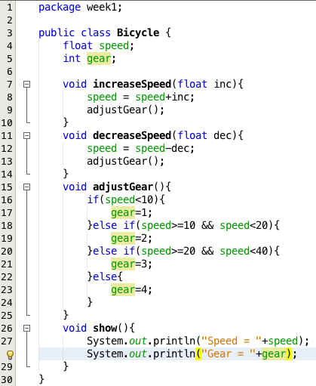
Sorce Code
Declaring Class
Declaring Attribute
Declaring Method

Slide 28
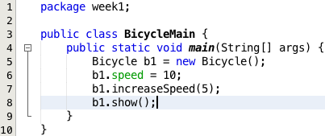
Ilustrasi Program
Instantiation
Calling method of object
Assigning value of attribute

Slide 29
7 - Constructor
Constructor is a special method that creates object.
Special???
Constructor name is the same with class name
Constructor does not have any datatype, thus it will not need any return statement
Constructor will run only at instantion/object creation
Constructor can has parameter
One class can has more than one constructor

Slide 30
7 - Constructor
Constructor type:
Default Constructor:
Constructor that does not have any parameter
Parametric Constructor :
Constructor that has parameter
Example of Default Constructor:
public Bicycle(){
}
Example of Parametric Constructor
public Bicycle(float sp, int ge){
}

Slide 31
7 - Constructor
Constructor is used at instantion
Example:
Bicycle b1 = new Bicycle();
Bicycle b1 = new Bicycle(15.5, 2);

Slide 32
8 – Class Diagram
Bicycle
speed: float
gear: int
increaseSpeed(): void
decreaseSpeed(): void
adjustGear(): void
show(): void

